Slide 1

EduBotics
Enhancing Education with AI-Powered Interactive Learning Platform for KIET

Slide 2
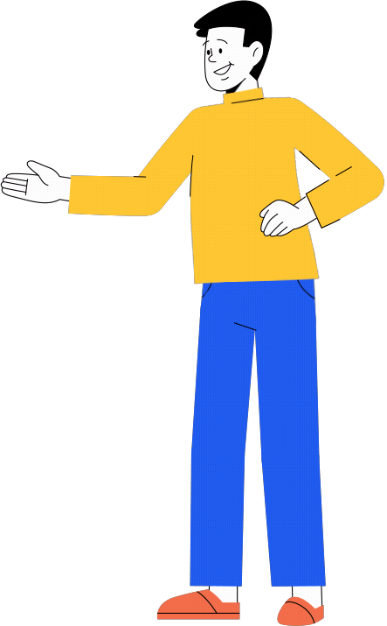
Objectives::
Enhanced User Engagement
Personalized Experience Efficient Resource Retrivall
Creative User Experience

Slide 3
Avatar development by Ai
1
tools
Website User Interface
2
(UI) Design Website develeopment
Tech Stack
3
using HTML,CSS,JS Chatbot Implimentation
4
using NLP Figma
5

Slide 4

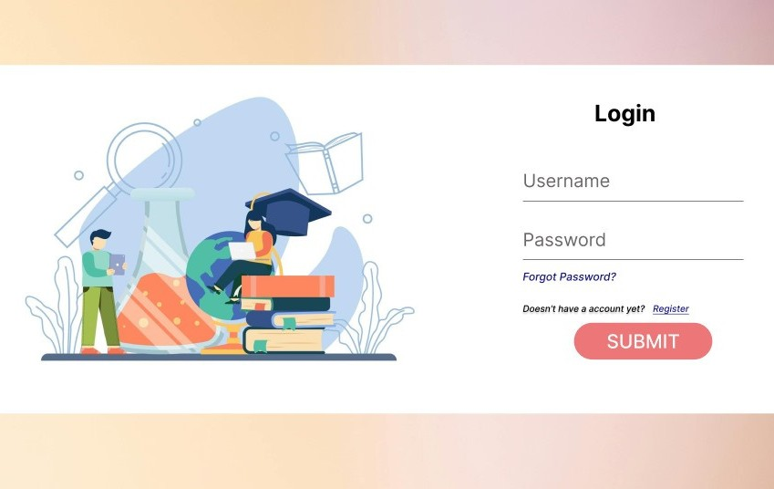
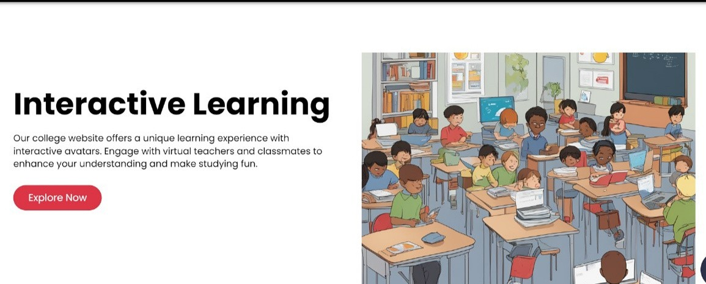
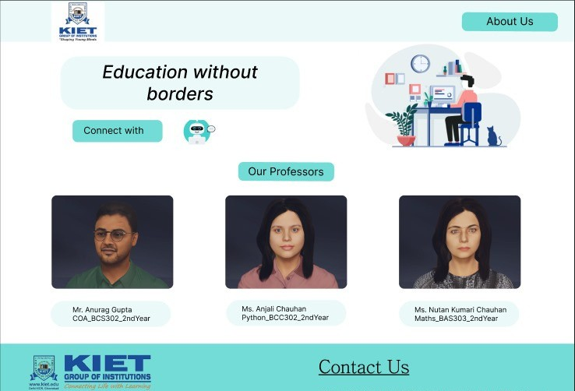
Implementation

Slide 5

Avatar Demo

Slide 6
Work flow
Feedback Loop
Development
Deployment
Content
Design
U
pload
Requirement
P
hase
Gathering

Slide 7









Future Scope
Personalized Learning Paths
Enable personalized learning paths,
tailoring material based on student
preferences and learning styles.
Expansion of Teacher Avatars
Integrate gamification
Expand avatar variety to include more subjects, broadening
study material accessibility for students.
quizzes challenges, and virtual
labs for engaging learning.

Slide 8
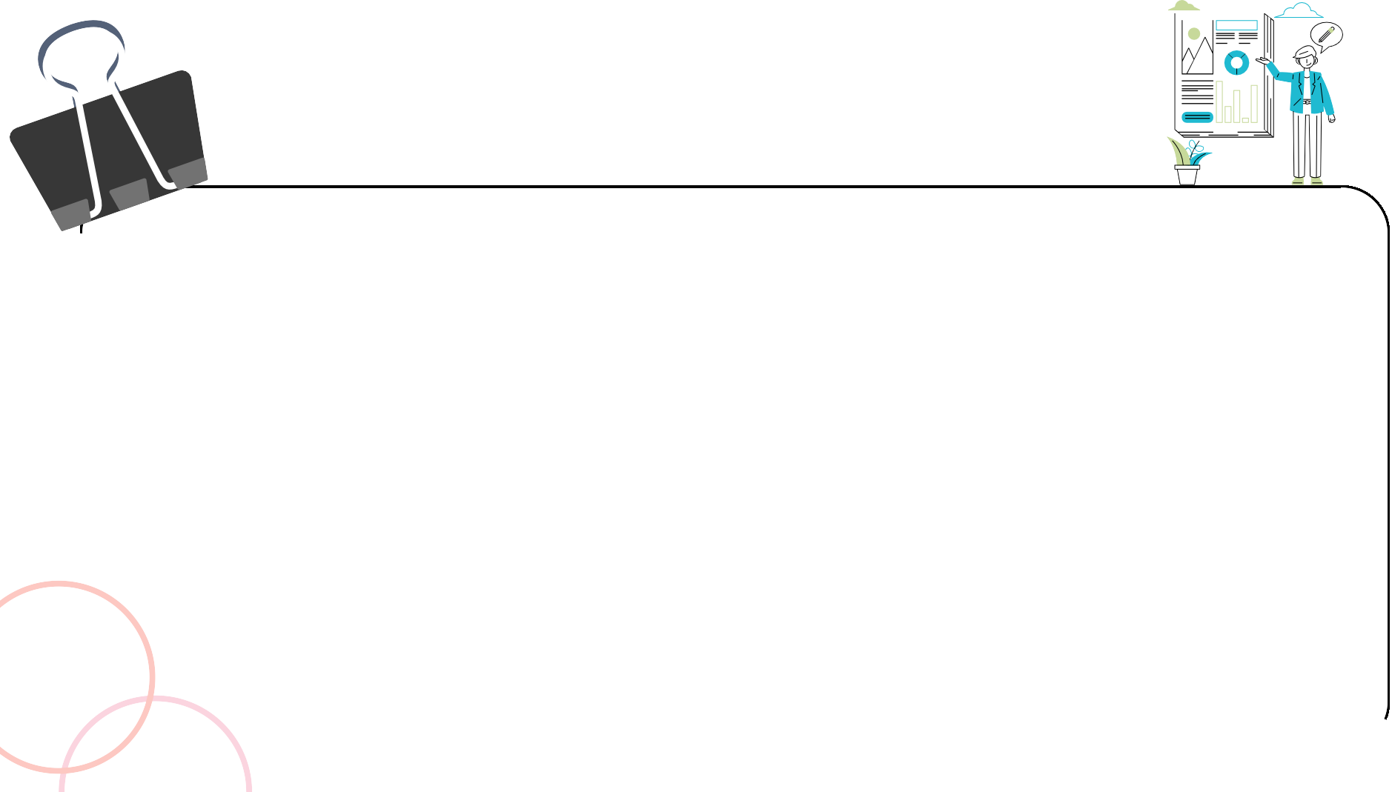
CONCLUSION
- Project signifies a significant advancement in education at our college.
Introduction of AI avatars of teachers and a user-friendly chatbot.
- Transformation in how students access study materials and interact with educators.
Promotes readily available resources and improves teacher- student interactions in the digital era.
Commitment to expanding subjects, refining AI avatars, and valuing 1college community feedback.
Gratitude towards college, teachers, and team members for their support.

Slide 9




Mentors
Mahi
kanika

Slide 10










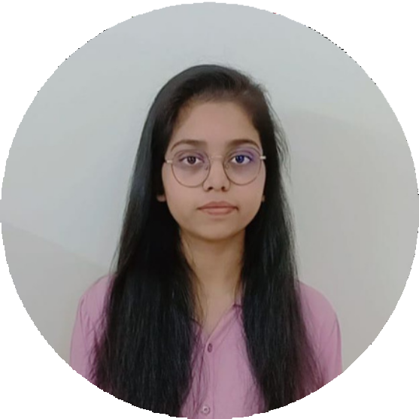

Team Members
Sarthak Sharma
Vidit Jain
Uma Yadav
Divya Verma
sameeksha
Sharaddha Kushwaha

Slide 11



Thank You!

